Slide 1
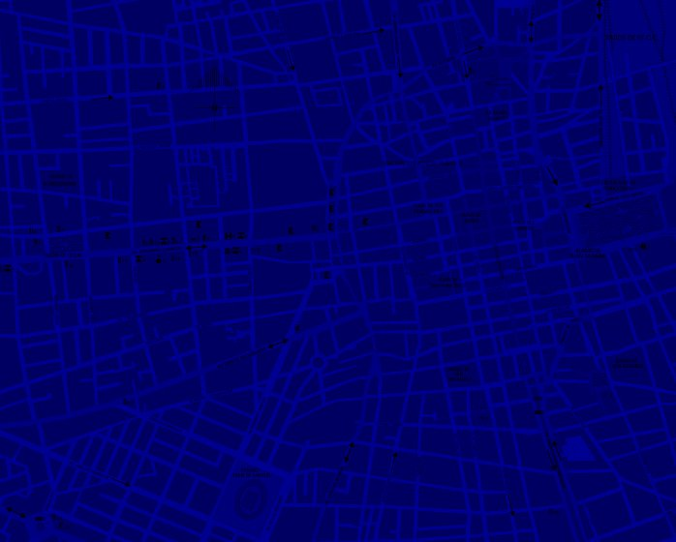
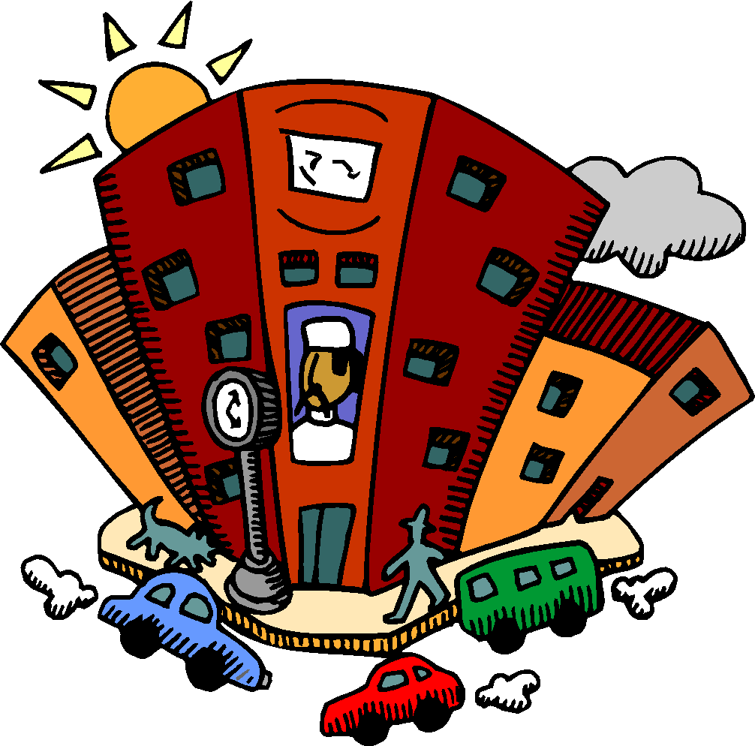


Slide 2



home
house

Slide 3
You live at home.
You can do many things at home.
home

Slide 4
1 / 38
I can paint at home.
I can play video games at home.
I can dance at home.
I can sing at home.
I can sleep at home.
I can read at home.
I can cook at home.
I can watch t.v. at home.
I can do my homework at home.
I can play football at home.
I can play at home.
home

Slide 5
1 / 38
I can play with my brother (sister / family) at home.
I can eat at home.
I can drink at home.
I can run at home.
I can jump at home.
I can watch videos at home.
I can clean at home.
I can make my bed at home.
home

Slide 6

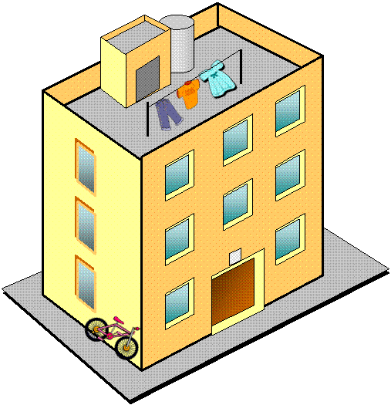

block of flats

Slide 7
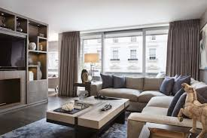
Who works in your house?

Slide 8
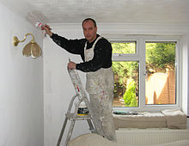
Who works in your house?
A painter works in your house.
stadium
painter

Slide 9
What does he/ she do?
He/ She paints the walls.
stadium
painter

Slide 10
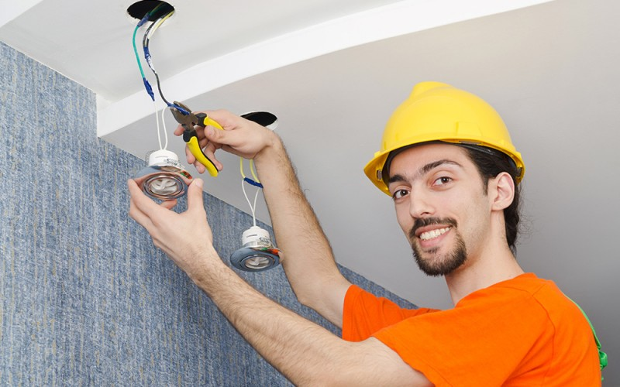
Who works in your house?
A electrician works in your house.
stadium
electrician

Slide 11
What does he/she do?
He/She fixes any electrical problems and installs new wiring.
stadium
electrician

Slide 12
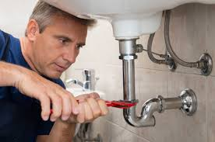
Who works in your house?
A plumber works in your house.
stadium
plumber

Slide 13
What does he/ she do?
He/ She repairs any water problems.
stadium
plumber

Slide 14
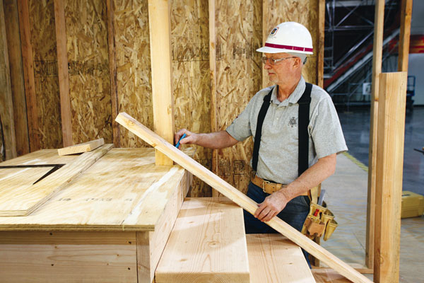
Who works in your house?
A carpenter works in your house.
stadium
carpenter

Slide 15
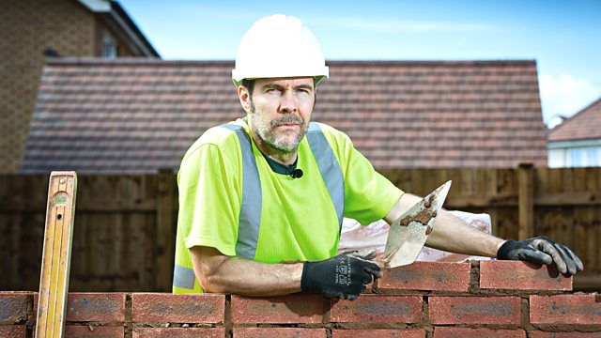
Who works in your house?
A builder works in your house.
stadium
builder

Slide 16
What does he/ she do?
He/ She builds houses and other buildings.
stadium
builder

Slide 17
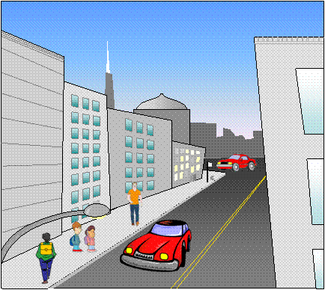
street

Slide 18
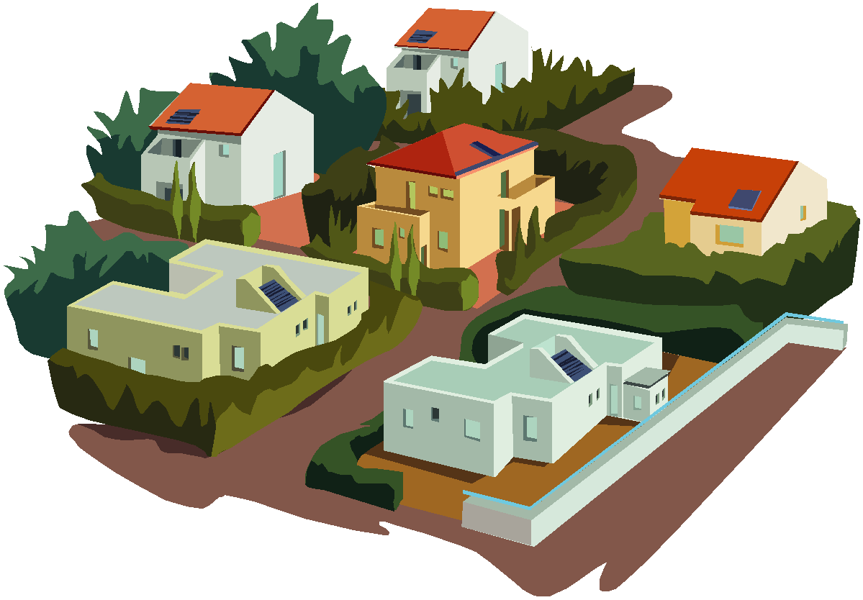
neighbourhood

Slide 19
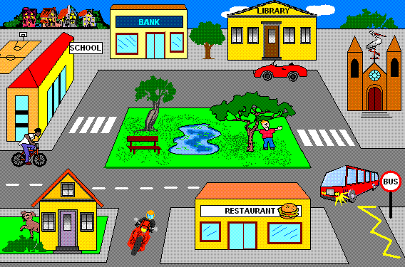
square

Slide 20
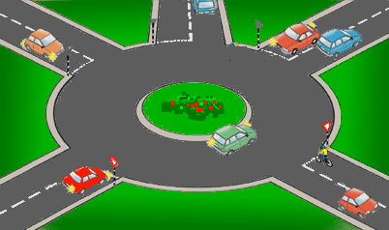
roundabout

Slide 21
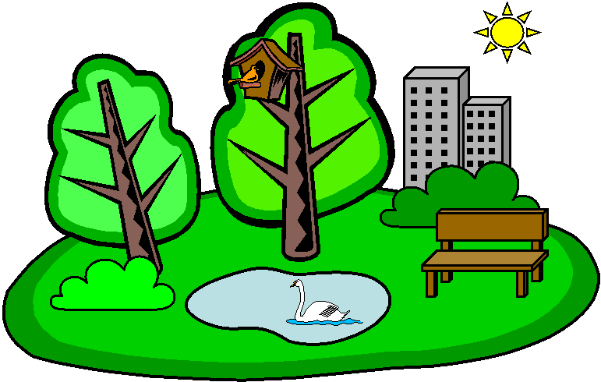
park

Slide 22
What can you do at the park?
You can play games at the park.
park

Slide 23
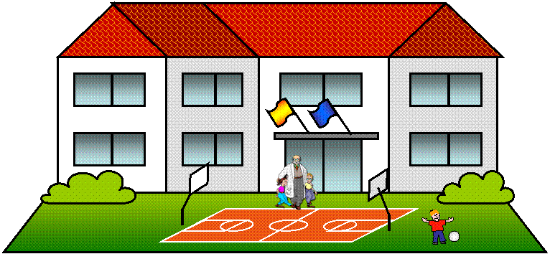
school

Slide 24
What can you do at school?
You can learn English at school!
school

Slide 25
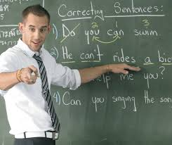
Who works at a school?
A teacher works at a school.
teacher
school

Slide 26
What does he/ she do?
He/ She teaches a subject.
teacher
school

Slide 27
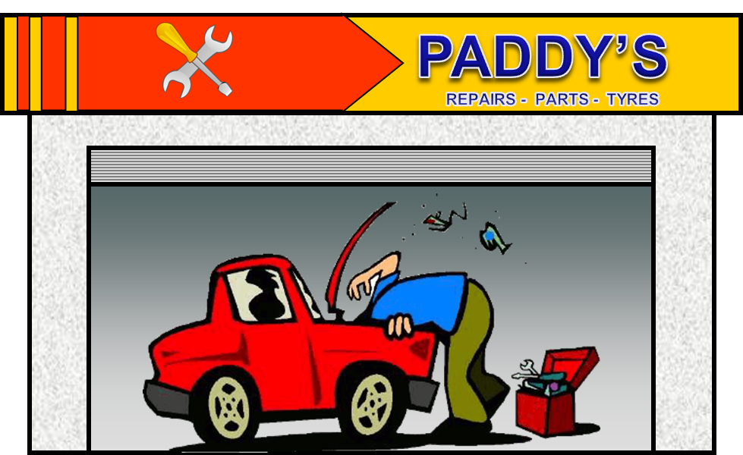

38 / 38
garage

Slide 28
38 / 38
What can you do at the garage?
You can get your car fixed at the garage.
garage

Slide 29
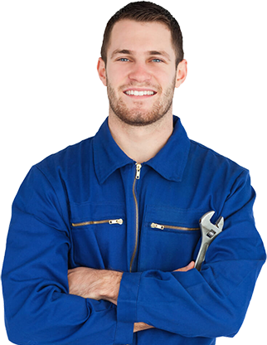
Who works at the garage?
A mechanic works at the garage.
stadium
mechanic

Slide 30
What does he/ she do?
He/ She fixes cars.
stadium
mechanic

Slide 31
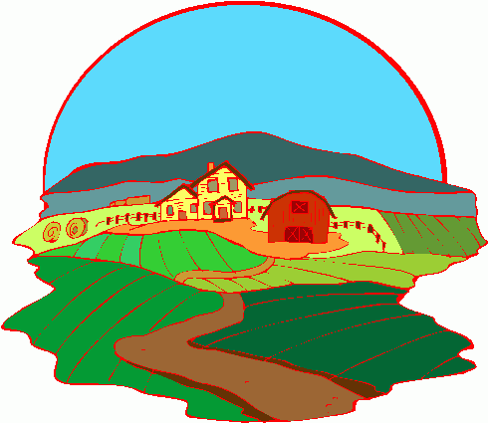
38 / 38
farm

Slide 32
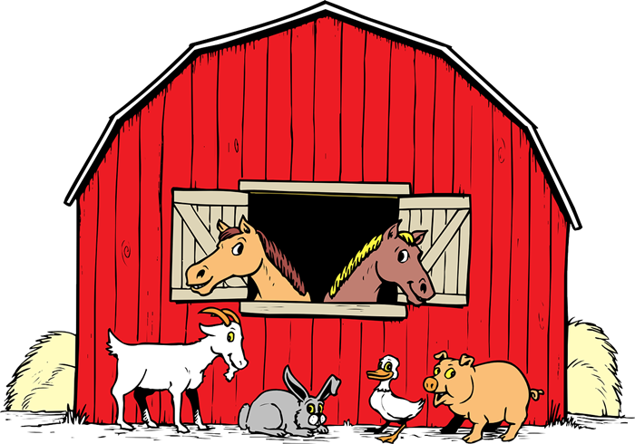
38 / 38
What can you do at the farm?
You can see animals on the farm.
farm

Slide 33
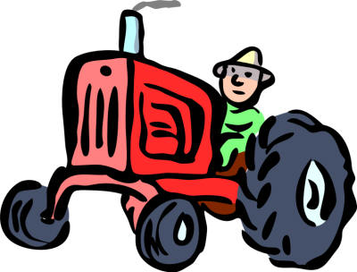
Who works on the farm?
A farmer works on the farm.
stadium
farmer

Slide 34
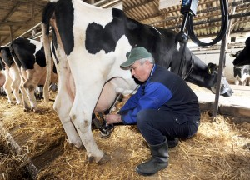
What does a farmer do?
A farmer milks cows.
stadium
farmer

Slide 35
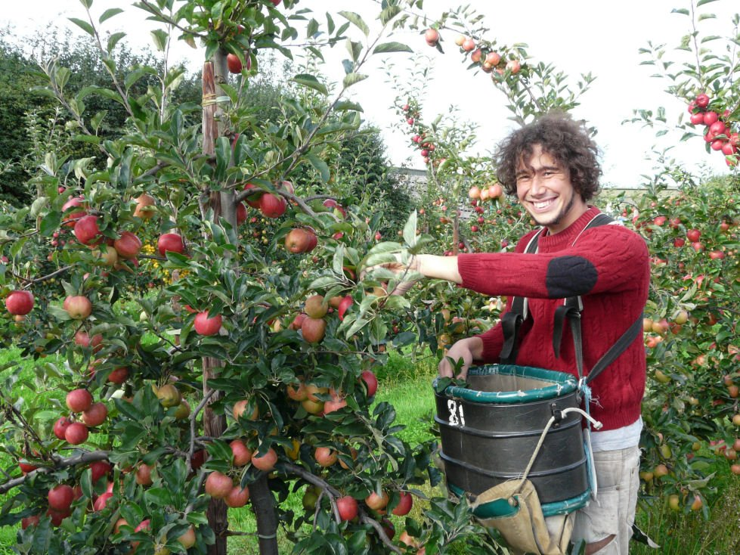
What does a farmer do?
A farmer picks fruit.
stadium
farmer

Slide 36
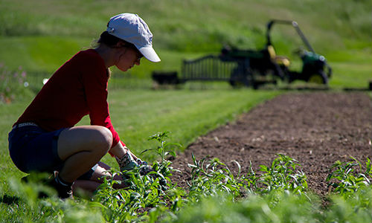
What does a farmer do?
A farmer grows plants.
stadium
farmer

Slide 37
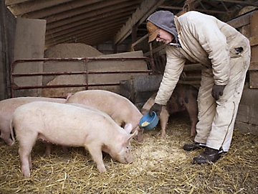
What does a farmer do?
A farmer feeds pigs.
stadium
farmer

Slide 38
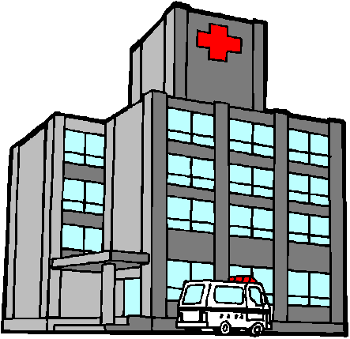
hospital

Slide 39
What can you do at the hospital?
You can get better at the hospital.
hospital

Slide 40

Who works at the hospital?
A doctor works at the hospital.
stadium
doctor

Slide 41
What does he/ she do?
He/ She helps people get better.
stadium
doctor

Slide 42

What does he/ she do?
He/ she helps people get better.
stadium
nurse

Slide 43
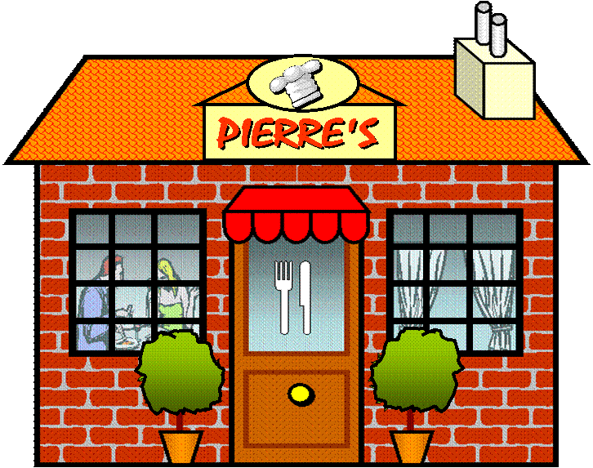
restaurant

Slide 44
What can you do at the restaurant?
You can eat at the restaurant.
restaurant

Slide 45
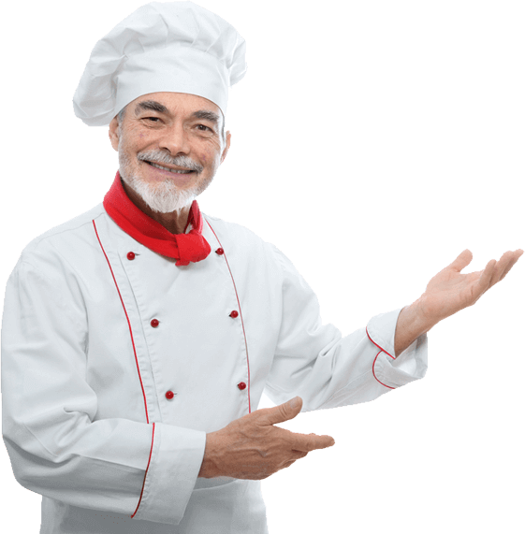
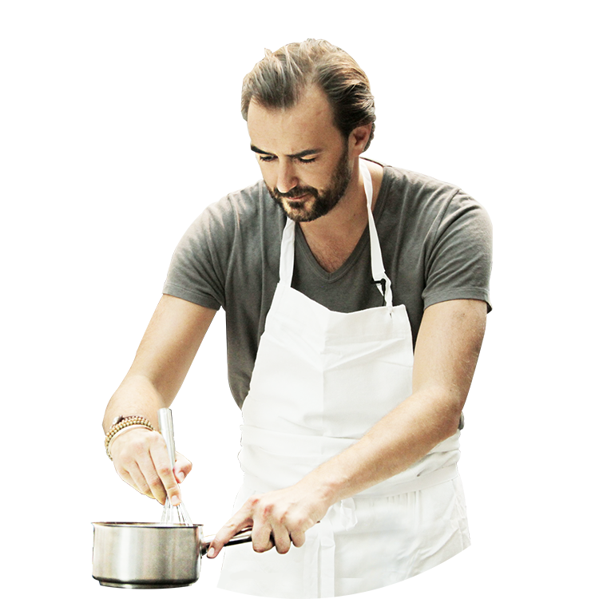
Who works at the restaurant?
A chef/cook works at the restaurant.
chef/ cook

Slide 46
What does he/ she do?
He/ She cooks food.
chef/ cook

Slide 47
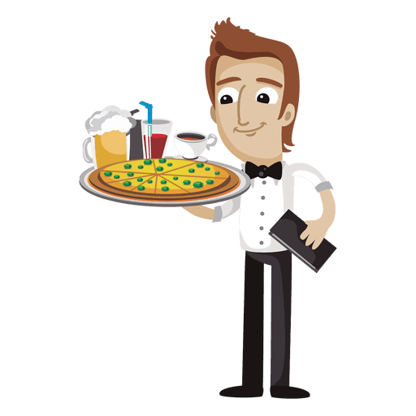
Who works at the restaurant?
A waiter works at the restaurant.
waiter

Slide 48
Who works at the restaurant?
He/ She takes your order and brings you your food.
waiter

Slide 49
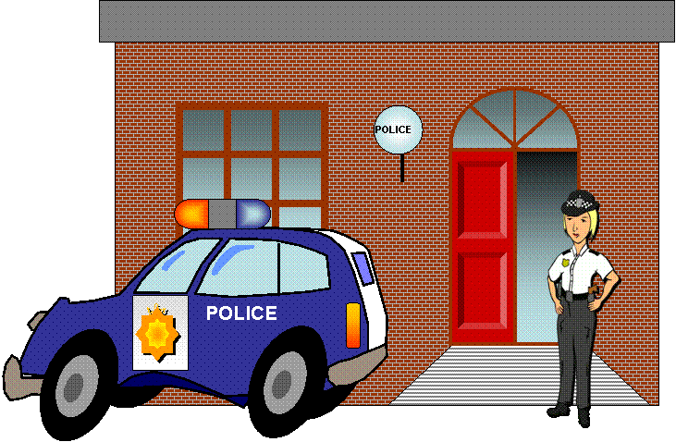
police station

Slide 50
What can you do at the police station?
You can get help at the police station.
police station

Slide 51
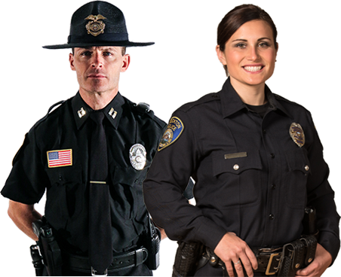
Who works at the police station?
A police officer works at the police station.
stadium
police officer

Slide 52
What does he/ she do?
He/ She helps you if you have a problem.
stadium
police officer

Slide 53
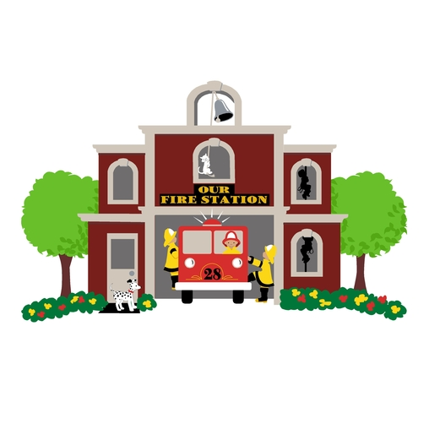


fire station
/f/
/ie/
/r/
/s/
/t/
/ai/
/sh/
/u/
/n/

Slide 54
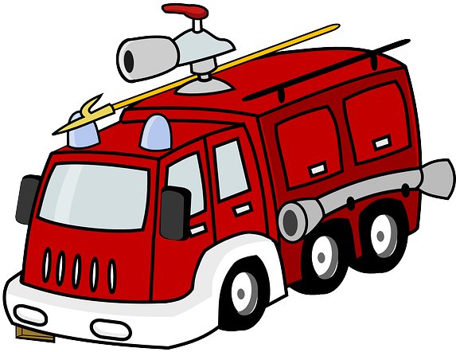
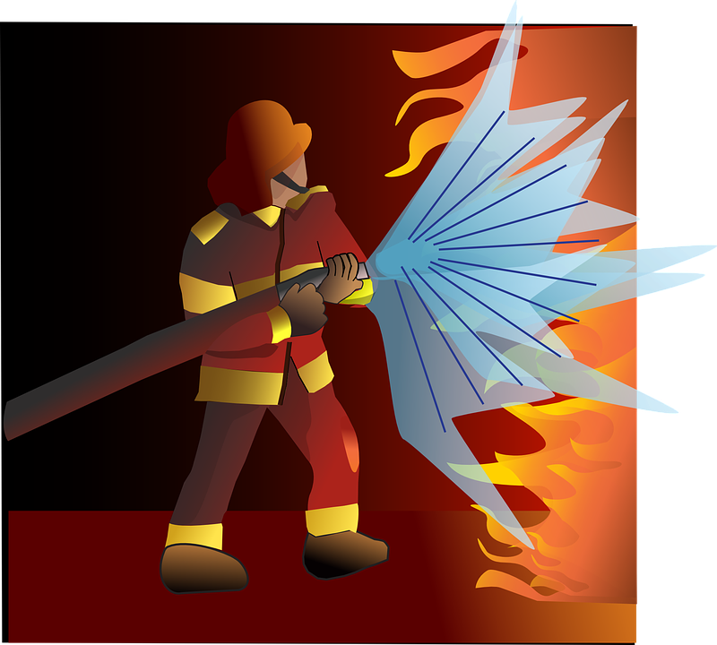
OCCUPATIONS
fire fighter
/f/
/ie/
/r/
/f/
/ie/
/t/
/er/

Slide 55
OCCUPATIONS
What does he/ she do?
He/ She puts out fires.
fire fighter
/f/
/ie/
/r/
/f/
/ie/
/t/
/er/

Slide 56
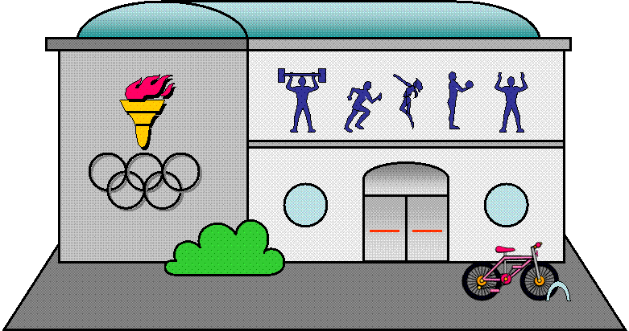
sports centre

Slide 57
What can you do at the sports center?
You can play sports at the sport centre.
sports centre

Slide 58
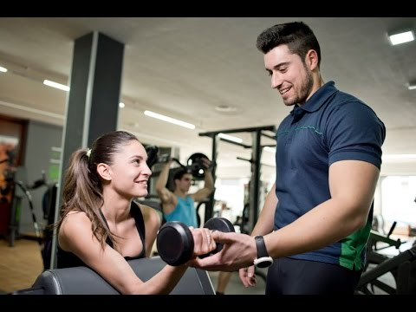
Who works at the sports center?
A gym instructor works at the sport centre.
Gym instructor
sports center

Slide 59
What does he/ she do?
He/ She helps you get fitter.
Gym instructor
sports center

Slide 60
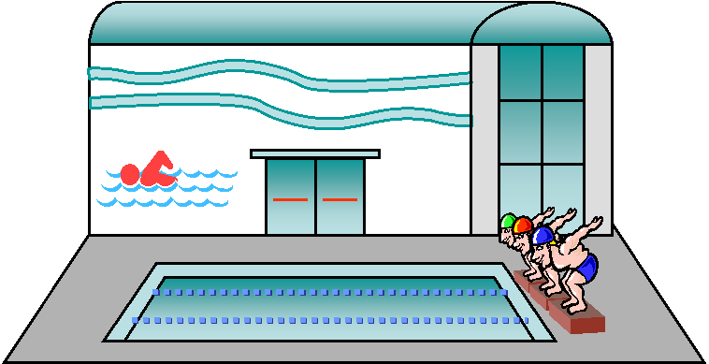
swimming pool

Slide 61
What can you do at the swimming pool?
You can swim at the swimming pool.
swimming pool

Slide 62
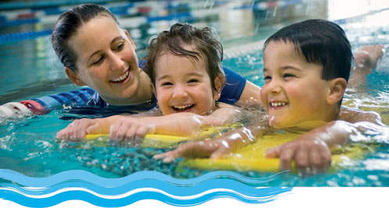
Who works at the swimming pool?
A swimming instructor works at the swimming pool.
Swimming instructor
swimming pool

Slide 63
What does he/ she do?
He/ She teaches you how to swim.
Swimming instructor
swimming pool

Slide 64
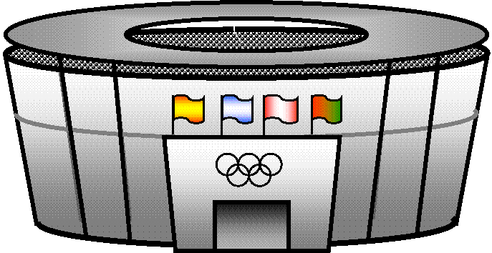
stadium

Slide 65
What can you do at the stadium?
You can watch sports at the stadium.
stadium

Slide 66

Who works at the stadium?
A football player works at the stadium.
stadium
football player

Slide 67
What does he/ she do?
He/ She plays football.
stadium
football player

Slide 68
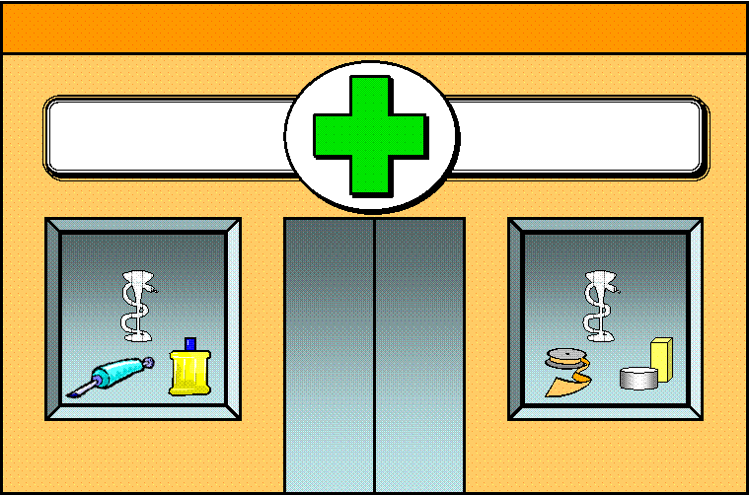
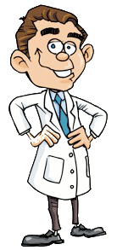
pharmacy

Slide 69
What can you do at the pharmacy?
You can buy medicine at the pharmacy.
pharmacy

Slide 70

Who works at the pharmacy?
A pharmacist works at the pharmacy.
pharmacist

Slide 71
What does he/ she do?
He/ She sells medicine.
pharmacist

Slide 72

library

Slide 73
What can you do at the library?
You can read a book at the library .
You can borrow a book at the library .
library

Slide 74

Who works at the library?
A libriarian works at the library .
libriarian

Slide 75
What does he/ she do?
He/ She loans books .
libriarian

Slide 76
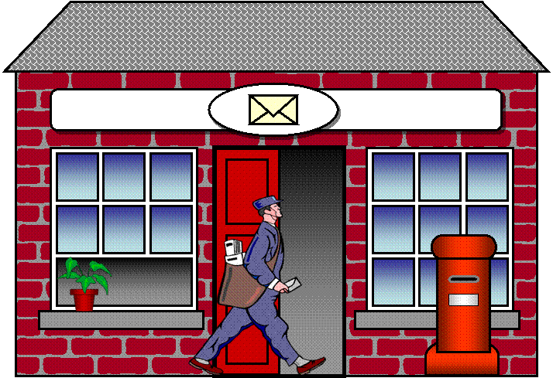
post office

Slide 77


What can you do at the post office?
You can get post at the post office.
You can buy stamps at the post office.
You can send post at the post office.
post office

Slide 78
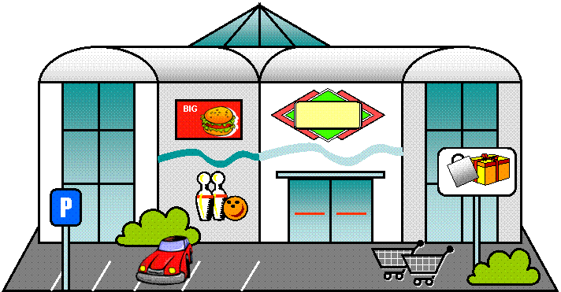
shopping centre

Slide 79
What can you do at the shopping centre?
You can buy lots of things at the shopping centre.
shopping centre

Slide 80
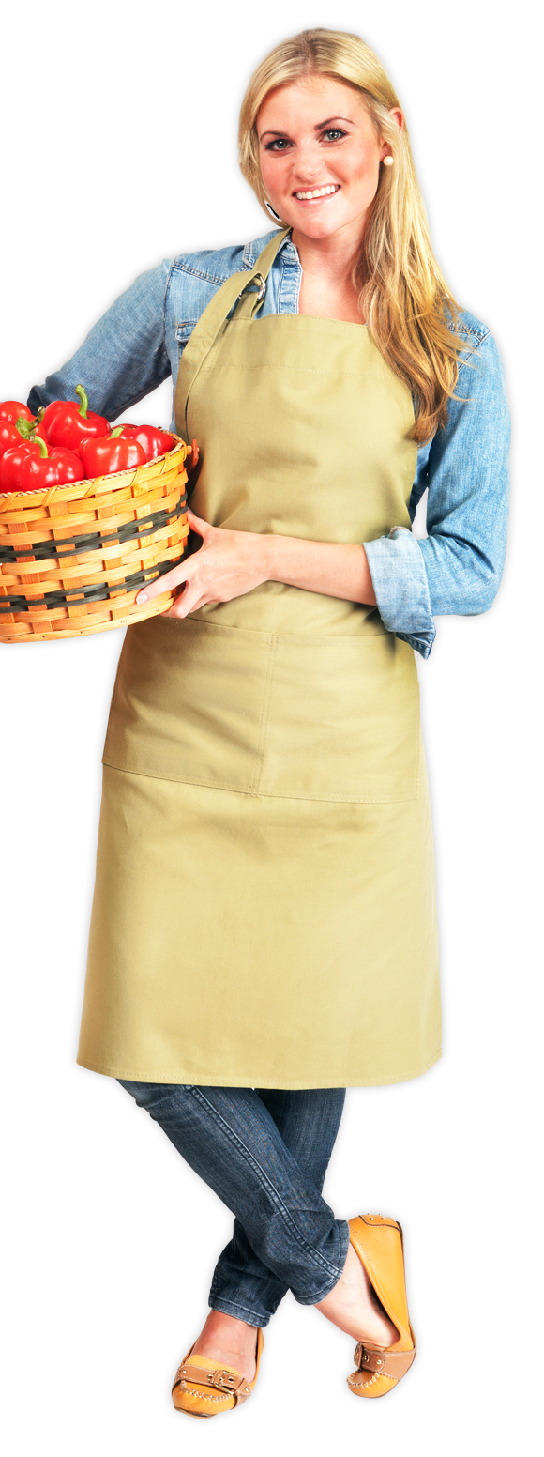
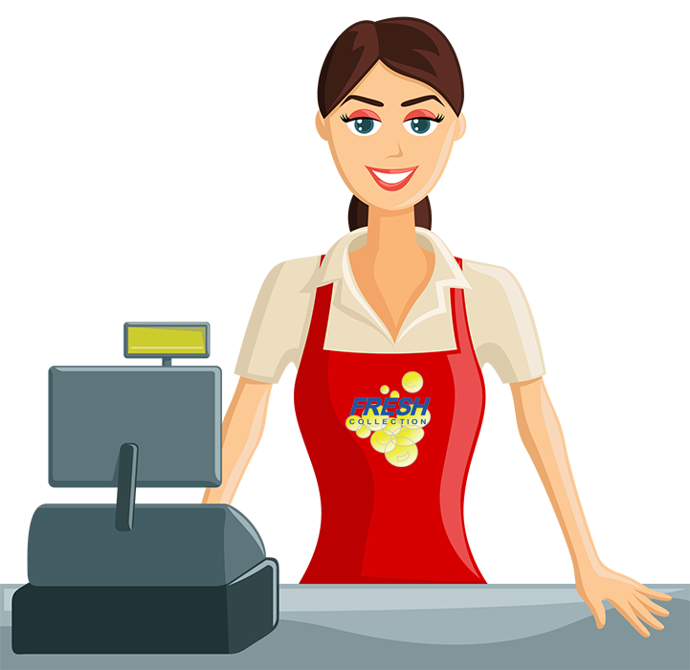
Who works at the shopping centre?
A shop assistant works at the shopping centre.
stadium
Shop assistant

Slide 81
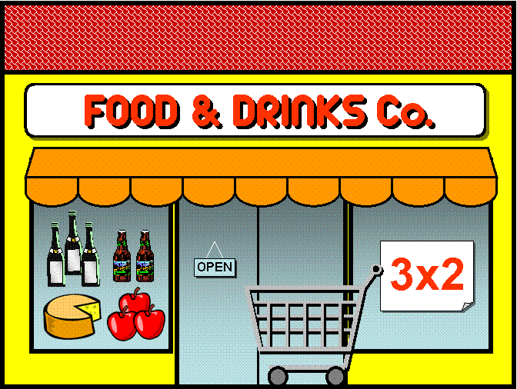
supermarket

Slide 82
What can you do at the supermarket?
You can buy food at the supermarket.
supermarket

Slide 83
Who works at the supermarket?
A shop assistant works at the supermarket.
stadium
Shop assistant

Slide 84
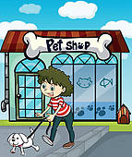
pet shop

Slide 85
What can you do at the pet shop?
You can buy a pet at the pet shop.
pet shop

Slide 86

book shop

Slide 87
What can you do at the book shop?
You can buy books at the book shop.
book shop

Slide 88
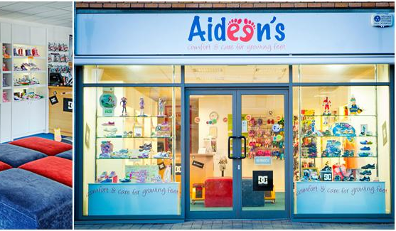
shoe shop

Slide 89
What can you do at the shoe shop?
You can buy shoes at the shoe shop.
shoe shop

Slide 90
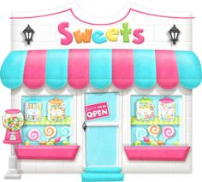
sweet shop

Slide 91
What can you do at the sweet shop?
You can buy sweets at the sweet shop.
sweet shop

Slide 92

clothes shop

Slide 93
What can you do at the clothes shop?
You can buy clothes at the clothes shop.
clothes shop

Slide 94

music shop

Slide 95
What can you do at the music shop?
You can buy a music cd at the music shop.
You can buy a music instrument at the music shop.
music shop

Slide 96

greengrocer’s

Slide 97
What can you do at the greengrocer’s?
You can buy fruit and vegetables at the greengrocer’s.
greengrocer’s

Slide 98

Who works at the greengrocer’s?
A greengrocer works at the greengrocer’s.
stadium
greengrocer

Slide 99

bakery

Slide 100
What can you do at the bakery?
You can buy bread at the bakery.
bakery

Slide 101

Who works at the bakery?
A baker works at the bakery.
stadium
baker

Slide 102

butcher’s

Slide 103
What can you do at the butcher’s?
You can buy meat at the butcher’s.
butcher’s

Slide 104

Who works at the butcher’s?
A butcher works at the butcher’s.
stadium
butcher

Slide 105

hairdresser’s

Slide 106
What can you do at the hairdresser’s?
You can get a haircut at the hairdresser’s.
hairdresser’s

Slide 107


Who works at the hairdresser’s?
A hairdresser works at the hairdresser’s.
stadium
hairdresser

Slide 108

bus station

Slide 109
What can you do at the bus station?
You can get a bus at the bus station.
bus station

Slide 110


Who works at the bus station?
A bus driver works at the bus station.
stadium
bus driver

Slide 111
bus station

Slide 112
What can you do at the bus station?
You can get a bus at the bus station.
bus station

Slide 113
Who works at the bus station?
A bus driver works at the bus station.
stadium
bus driver

Slide 114


20 | 19 Question * | 18 | 17
13 | 14 Question * | 15 | 16
12 | 11 Question * | 10 | 9
5 Question* | 6 | 7 | 8 Question *
4 | 3 Question * | 2 | 1

Slide 115
English 1 |  | A/ An (column 1) ..
accountant | contable | helps companies manage money
cleaner | Persona de limpieza | cleans and tidies an area or a place
fireman | bombero/a | puts out or extinguish fires
nurse | enfermero/a | is trained to help doctors and look after the sick.
scientist | científico/a | does experiments to discover how the world works
architect | arquitecto/a | designs houses, buildings and structures
dentist | dentista | looks after people’s teeth and gums
fisherman | pescador/a | catches fish in the river or sea to sell

Slide 116
English 1 |  | A/ An (column 1) ..
painter | pintor/a | paints paintings or objects
secretary | secretario/a | works in an office
builder | albañil | constructs buildings
doctor | medico | helps people get better
hairdresser | peluquero/a | cuts your hair or gives it a new style
pilot | piloto | flies a plane
shopkeeper | tendero/a | owns and runs a shop
bus driver | Chofer de autobús | drives a bus
electrician | electricista | fixes electrical objects including houses
journalist | periodista | writes for a newspaper or magazine

Slide 117
English 1 |  | A/ An (column 1) ..
plumber | fontanero | fixes the water pipes in a building
Taxi driver | taxista | drives a taxi
butcher | carnicero | prepares meat to eat
engineer | ingeniero/a | makes designs work
lawyer | abogado/a | helps people with legal problems
police officer | policia | helps people in trouble
teacher | profesor/a | teaches students new information
carpenter | carpintero/a | makes things with wood
factory worker | trabajador/a de fábrica | works in a factory
librarian | bibliotecario/a | Helps run a library

Slide 118
English 1 |  | A/ An (column 1) ..
postman | cartero/a | delivers the mail
vet | veterinario/a | looks after sick animals
chef/ cook | cocinero/a | cooks food
farmer | granjero/a | grows food
mechanic | mecanico/a | Fixes and maintains, especially cars and other motor vehicles
receptionist | recepionisto/a | talks to the public in an office
waiter/ waitress | camarero/ a | serves food to the customers in restaurants

Slide 119
English 1
To help | ayudar
To fix | reparar
To tidy | ordenar
To maintain | mantener
To own | poseer
To run | correr
To sell | vender
To look after | cuidar
To serve | atender

Slide 120

34 / 38
zoo

Slide 121
34 / 38
What can you do at the zoo?
You can look at animals at the zoo.
zoo

Slide 122

12 / 38
cinema

Slide 123
12 / 38
What can you do at the cinema?
You can watch a film at the cinema
cinema

Slide 124

13 / 38
bowling alley

Slide 125
13 / 38
What can you do at the bowling alley?
You can go bowling at the bowling alley.
bowling alley

Slide 126

44 / 38
church

Slide 127
44 / 38
What can you do at the church?
You can pray at the church.
church

Slide 128

theme park

Slide 129
What can you do at the theme park?
You can go on a ride at the theme park.
theme park

Slide 130

newsagent’s

Slide 131
What can you do at the newsagent’s?
You can buy a newspaper at the newsagent’s.
newsagent’s

Slide 132
36 / 38
ice rink

Slide 133
36 / 38
What can you do at the ice rink?
You can go ice-skating at the ice rink.
ice rink

Slide 134

35 / 38
aquarium

Slide 135
35 / 38
What can you do at the aquarium?
You can look at fish at the aquarium.
aquarium

Slide 136

37 / 38
ENTRANCE
EXIT
car park

Slide 137
37 / 38
ENTRANCE
EXIT
What can you do at the car park?
You can park your car at the car park.
car park

Slide 138

town hall

Slide 139
What can you do at the town hall?
You can do lots of things at the town hall.
town hall

Slide 140

petrol station

Slide 141
What can you do at the petrol station?
You can buy petrol for your car at the petrol station.
petrol station

Slide 142

museum

Slide 143
What can you do at the museum?
You can look at old things like statues and paintings at the museum.
museum

Slide 144

bank

Slide 145

What can you do at the bank?
You can get money at the bank.
bank

Slide 146

café

Slide 147
What can you do at the café?
You can drink coffee at the café.
café

Slide 148
Where is the restaurant?
The restaurant is next to the butcher’s.

Slide 149
Where is the post office?
The post office is next to the newsagent’s.

Slide 150
Where is the bank?
The bank is next to the hospital.

Slide 151
Where is the bank?
The bank is between the hospital and the bookshop.

Slide 152
Where is the swimming pool?
The swimming pool is between the shopping center and the stadium.

Slide 153
Where is the your home?
My home is between the garage and the park.

Slide 154


